Slide 1

AREC Contest: House Sale Price Prediction
By
Roland Villafuerte

Slide 2

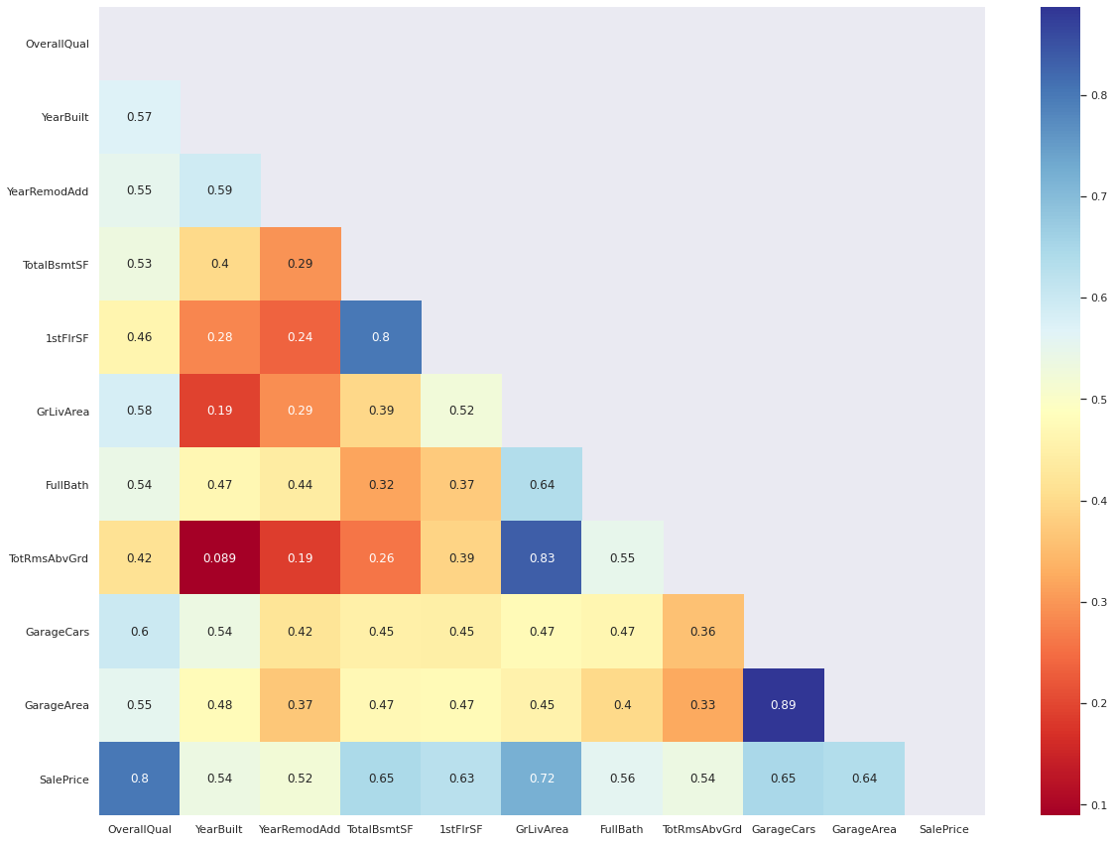
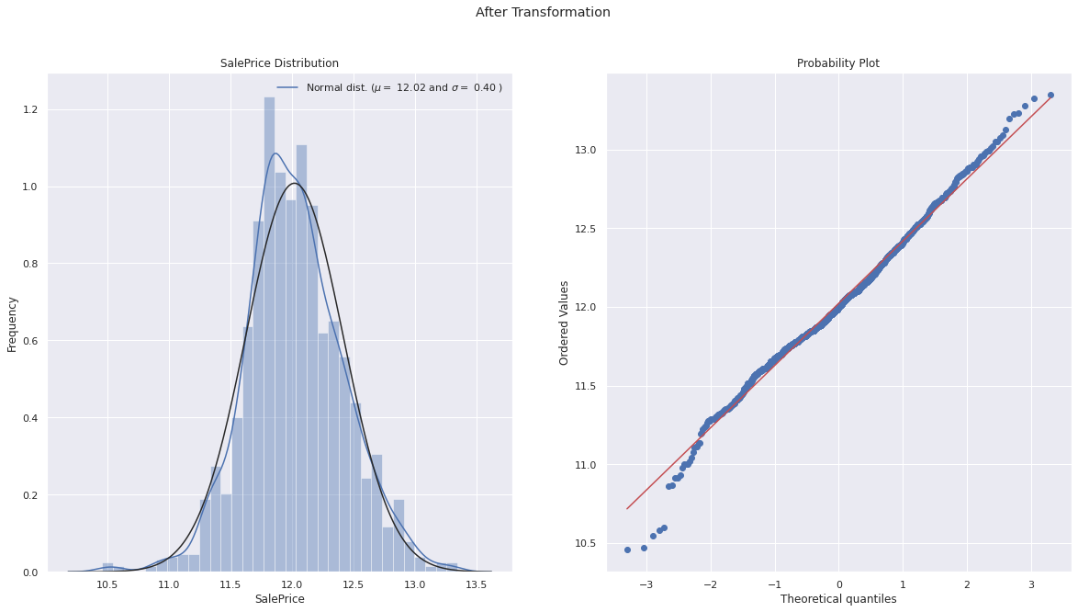
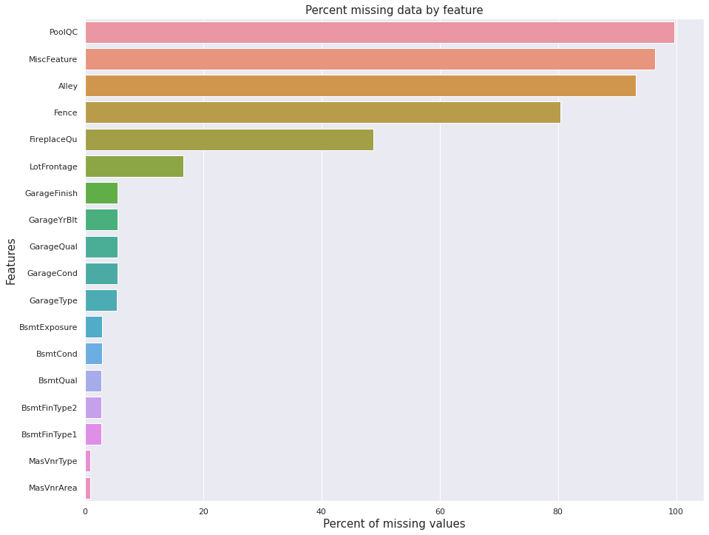
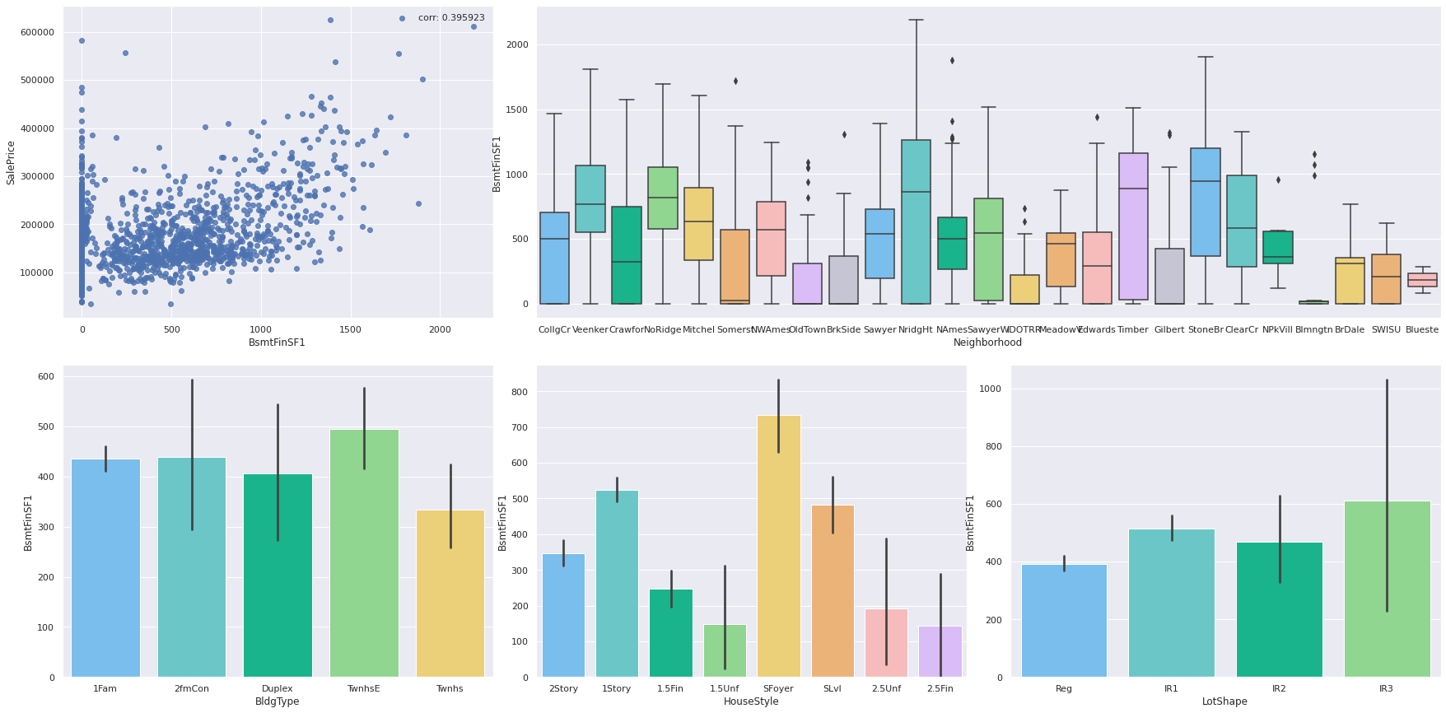
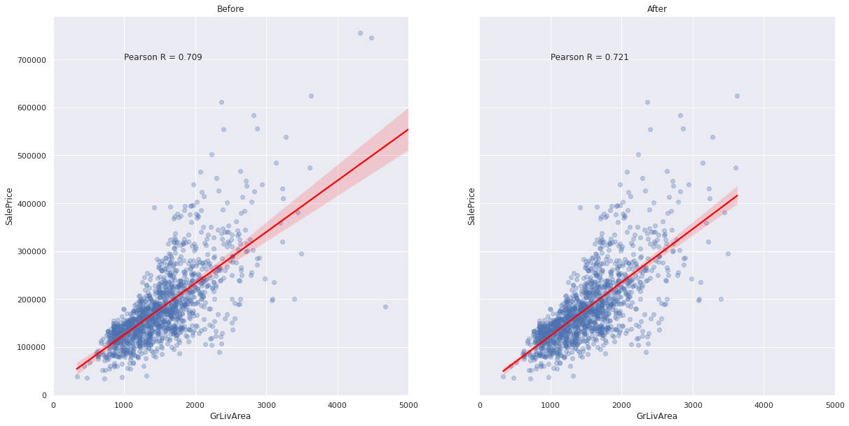
Avg. $0.13 Error for every $1.00
Conclusion

Slide 3

Who Cares?

Slide 4

Recommendations
Infrastructure
Culture
Goals and Teams

Slide 5


Infrastructure
Productionize model
Update model
Storage

Slide 6


Culture
What is Data?
Who needs it?
Domain Knowledge

Slide 7


Goals
Prediction
Emerging trends
Demographics

Slide 8

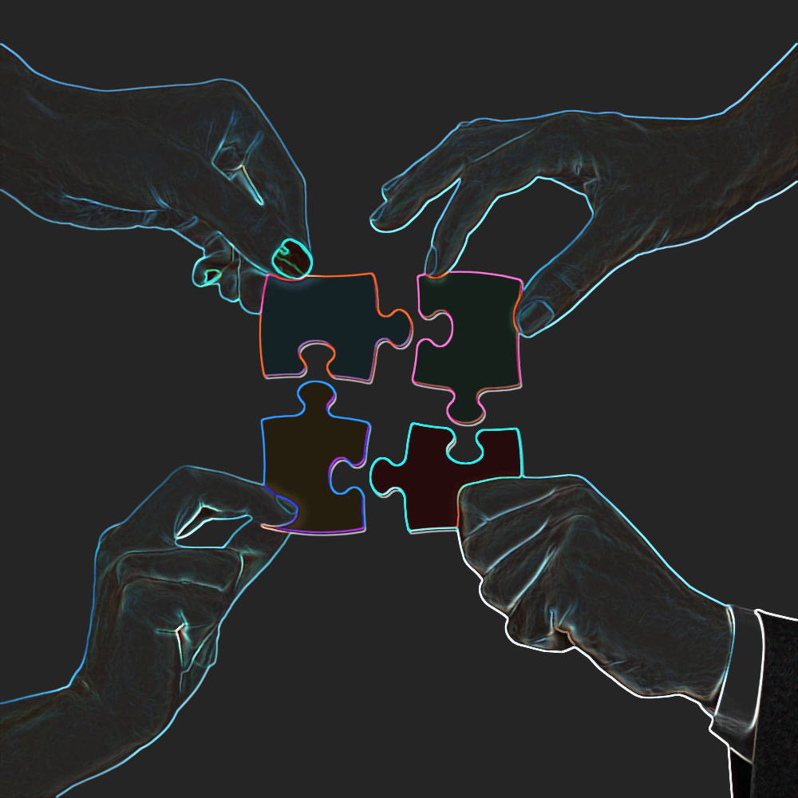
Teams
Cross-functional?
Explorative?

Slide 9


Solution
Partnership
Customer Service
Success

Slide 10


Opportunity
Investment
50%
Competitors
Survival

Slide 11
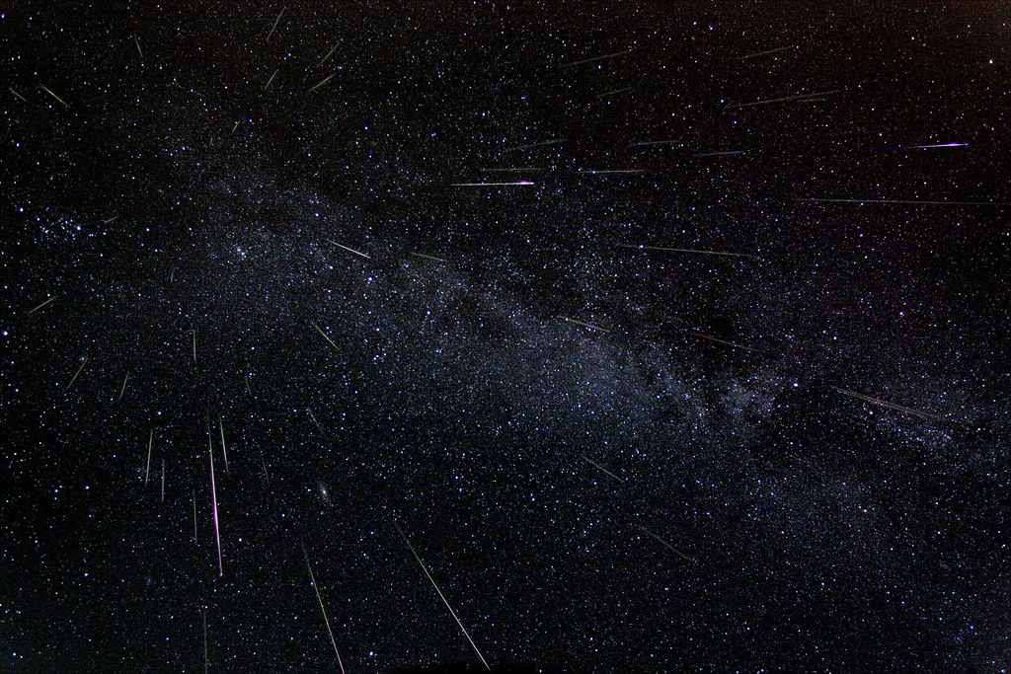
Thank you!
Questions?

